Slide 1
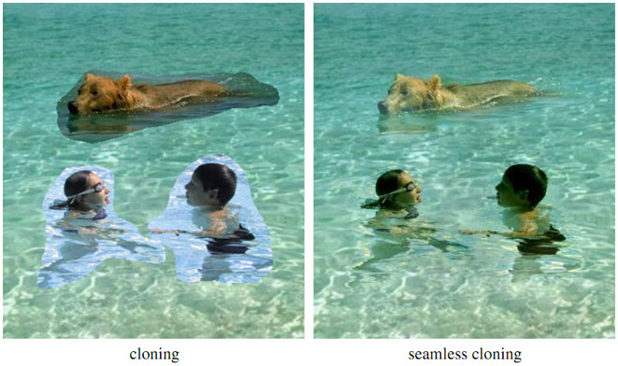

Filtering and resampling
Yoni Chechik
www.AIisMath.com

Slide 2
References
http://szeliski.org/Book/
http://www.cs.cornell.edu/courses/cs5670/2019sp/lectures/lectures.html
http://www.cs.cmu.edu/~16385/

Slide 3
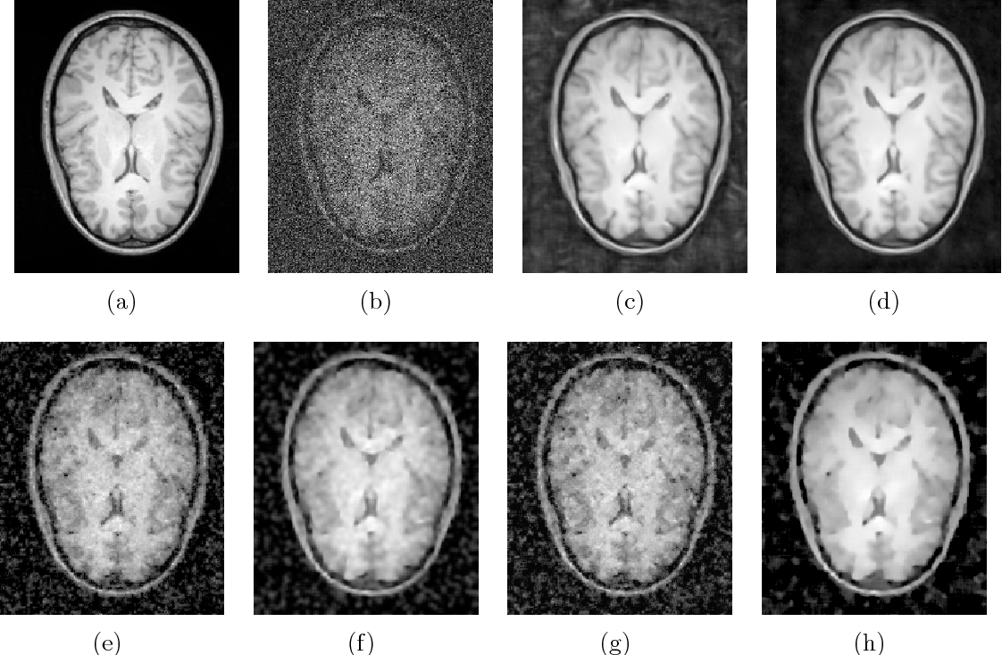
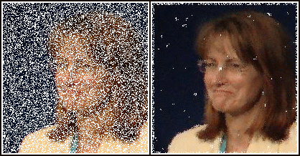
Some motivation
Medicine
(MRI denoising)
Image restoration

Slide 4
contents
Noise and filtering
Frequency representation
Decimation
Interpolation

Slide 5
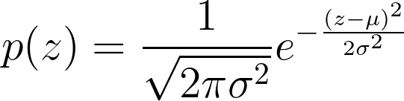
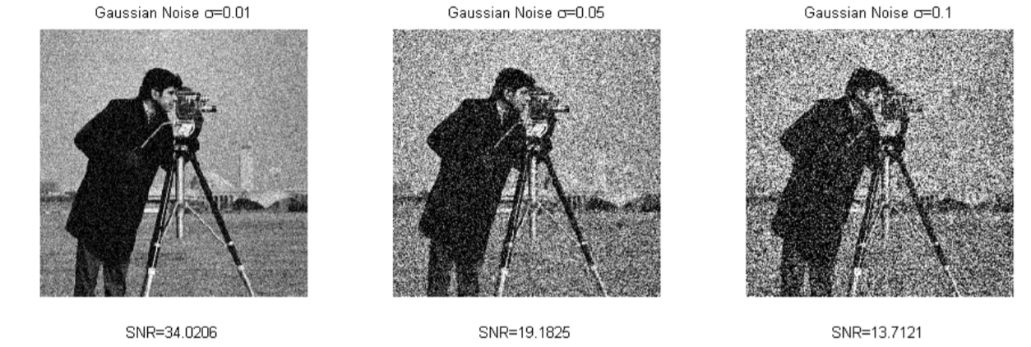
Gaussian Noise
Gaussian noise is an additive noise that can appear in images due to the system electrical circuitry.
This noise is independent of signal strength and independent at each pixel (IID- independent and identically distributed).

Slide 6
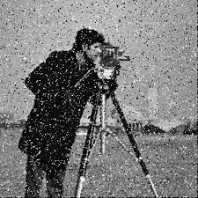
Salt & Pepper noise
Noise that can be caused by analog-to-digital converter errors, bit errors in transmission, etc.
This noise is not additive to the signal strength (a replacement of original value with noise value).
This noise is independent of signal strength and independent at each pixel.

Slide 7
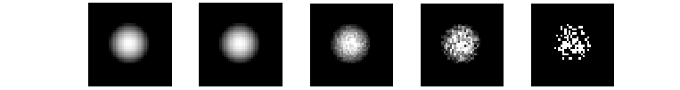
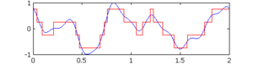
And some more noise
Shot noise - caused by statistical quantum fluctuations, that is, variation in the number of photons sensed at a given exposure level in the darker parts of an image (where there are just few photons that enter each pixel “bin”). Modeled as Poisson noise.
Quantization noise – caused by quantizing the pixels of a sensed image to several discrete levels (analog to digital conversion).

Slide 8
Noise reduction with LTI filters
LTI (LSI) filters are also known as convolution filters or kernel filters and are a known solution for the noise problem.
They are linear operators, which involve weighted combinations of pixels in small neighborhood, The combination is determined by the filter’s kernel.
The same kernel is shifted to all pixel locations so that all pixels use the same linear combination of their neighbors.
Shifting the output after the weighted combination vs. shifting the input and then doing weighted combination is the same- so shift-invariance.
That’s why it’s called linear shift-invariance filter.
LSI for short, but more commonly known by the name of the 1D signal filter- LTI, linear time-invariant.

Slide 9
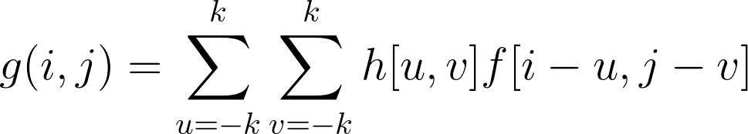
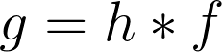
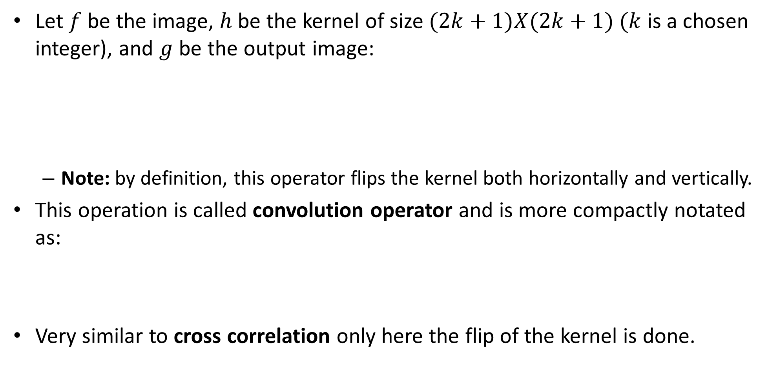
Convolution
Let $f$be the image, $h$ be the kernel of size $(2k+1)X(2k+1)$ $(k$ is a chosen integer), and $g$ be the output image:
Note: by definition, this operator flips the kernel both horizontally and vertically.
This operation is called convolution operator and is more compactly notated as:
Very similar to cross correlation only here the flip of the kernel is done.

Slide 10
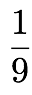
Example: mean filter
The kernel is:
Replaces pixel with local average.
Has smoothing (blurring) effect.
The kernel can be in any other size as well (see .ipynb).
1 | 1 | 1
1 | 1 | 1
1 | 1 | 1

Slide 11
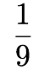
Run the filter
image
output
0 | 0 | 0 | 0 | 0 | 0 | 0 | 0 | 0 | 0
0 | 0 | 0 | 0 | 0 | 0 | 0 | 0 | 0 | 0
0 | 0 | 0 | 90 | 90 | 90 | 90 | 90 | 0 | 0
0 | 0 | 0 | 90 | 90 | 90 | 90 | 90 | 0 | 0
0 | 0 | 0 | 90 | 0 | 90 | 90 | 90 | 0 | 0
0 | 0 | 0 | 90 | 90 | 90 | 90 | 90 | 0 | 0
0 | 0 | 0 | 0 | 0 | 0 | 0 | 0 | 0 | 0
0 | 0 | 0 | 0 | 0 | 0 | 0 | 0 | 0 | 0
0 | 0 | 90 | 0 | 0 | 0 | 0 | 0 | 0 | 0
0 | 0 | 0 | 0 | 0 | 0 | 0 | 0 | 0 | 0
kernel
1 | 1 | 1
1 | 1 | 1
1 | 1 | 1
Note that we assume that the kernel coordinates are centered.
Here the kernel is symmetric horizontally and vertically, so the flipping is not noticeable.

Slide 12
Run the filter
image
output
0 | 0 | 0 | 0 | 0 | 0 | 0 | 0 | 0 | 0
0 | 0 | 0 | 0 | 0 | 0 | 0 | 0 | 0 | 0
0 | 0 | 0 | 90 | 90 | 90 | 90 | 90 | 0 | 0
0 | 0 | 0 | 90 | 90 | 90 | 90 | 90 | 0 | 0
0 | 0 | 0 | 90 | 0 | 90 | 90 | 90 | 0 | 0
0 | 0 | 0 | 90 | 90 | 90 | 90 | 90 | 0 | 0
0 | 0 | 0 | 0 | 0 | 0 | 0 | 0 | 0 | 0
0 | 0 | 0 | 0 | 0 | 0 | 0 | 0 | 0 | 0
0 | 0 | 90 | 0 | 0 | 0 | 0 | 0 | 0 | 0
0 | 0 | 0 | 0 | 0 | 0 | 0 | 0 | 0 | 0
 | 0
kernel
1 | 1 | 1
1 | 1 | 1
1 | 1 | 1

Slide 13
Run the filter
image
output
0 | 0 | 0 | 0 | 0 | 0 | 0 | 0 | 0 | 0
0 | 0 | 0 | 0 | 0 | 0 | 0 | 0 | 0 | 0
0 | 0 | 0 | 90 | 90 | 90 | 90 | 90 | 0 | 0
0 | 0 | 0 | 90 | 90 | 90 | 90 | 90 | 0 | 0
0 | 0 | 0 | 90 | 0 | 90 | 90 | 90 | 0 | 0
0 | 0 | 0 | 90 | 90 | 90 | 90 | 90 | 0 | 0
0 | 0 | 0 | 0 | 0 | 0 | 0 | 0 | 0 | 0
0 | 0 | 0 | 0 | 0 | 0 | 0 | 0 | 0 | 0
0 | 0 | 90 | 0 | 0 | 0 | 0 | 0 | 0 | 0
0 | 0 | 0 | 0 | 0 | 0 | 0 | 0 | 0 | 0
 | 0
kernel
1 | 1 | 1
1 | 1 | 1
1 | 1 | 1
shift

Slide 14
Run the filter
image
output
0 | 0 | 0 | 0 | 0 | 0 | 0 | 0 | 0 | 0
0 | 0 | 0 | 0 | 0 | 0 | 0 | 0 | 0 | 0
0 | 0 | 0 | 90 | 90 | 90 | 90 | 90 | 0 | 0
0 | 0 | 0 | 90 | 90 | 90 | 90 | 90 | 0 | 0
0 | 0 | 0 | 90 | 0 | 90 | 90 | 90 | 0 | 0
0 | 0 | 0 | 90 | 90 | 90 | 90 | 90 | 0 | 0
0 | 0 | 0 | 0 | 0 | 0 | 0 | 0 | 0 | 0
0 | 0 | 0 | 0 | 0 | 0 | 0 | 0 | 0 | 0
0 | 0 | 90 | 0 | 0 | 0 | 0 | 0 | 0 | 0
0 | 0 | 0 | 0 | 0 | 0 | 0 | 0 | 0 | 0
 | 0 | 10
kernel
1 | 1 | 1
1 | 1 | 1
1 | 1 | 1

Slide 15
Run the filter
image
output
0 | 0 | 0 | 0 | 0 | 0 | 0 | 0 | 0 | 0
0 | 0 | 0 | 0 | 0 | 0 | 0 | 0 | 0 | 0
0 | 0 | 0 | 90 | 90 | 90 | 90 | 90 | 0 | 0
0 | 0 | 0 | 90 | 90 | 90 | 90 | 90 | 0 | 0
0 | 0 | 0 | 90 | 0 | 90 | 90 | 90 | 0 | 0
0 | 0 | 0 | 90 | 90 | 90 | 90 | 90 | 0 | 0
0 | 0 | 0 | 0 | 0 | 0 | 0 | 0 | 0 | 0
0 | 0 | 0 | 0 | 0 | 0 | 0 | 0 | 0 | 0
0 | 0 | 90 | 0 | 0 | 0 | 0 | 0 | 0 | 0
0 | 0 | 0 | 0 | 0 | 0 | 0 | 0 | 0 | 0
 | 0 | 10 | 20
kernel
1 | 1 | 1
1 | 1 | 1
1 | 1 | 1

Slide 16
Run the filter
image
output
0 | 0 | 0 | 0 | 0 | 0 | 0 | 0 | 0 | 0
0 | 0 | 0 | 0 | 0 | 0 | 0 | 0 | 0 | 0
0 | 0 | 0 | 90 | 90 | 90 | 90 | 90 | 0 | 0
0 | 0 | 0 | 90 | 90 | 90 | 90 | 90 | 0 | 0
0 | 0 | 0 | 90 | 0 | 90 | 90 | 90 | 0 | 0
0 | 0 | 0 | 90 | 90 | 90 | 90 | 90 | 0 | 0
0 | 0 | 0 | 0 | 0 | 0 | 0 | 0 | 0 | 0
0 | 0 | 0 | 0 | 0 | 0 | 0 | 0 | 0 | 0
0 | 0 | 90 | 0 | 0 | 0 | 0 | 0 | 0 | 0
0 | 0 | 0 | 0 | 0 | 0 | 0 | 0 | 0 | 0
 | 0 | 10 | 20 | 30
kernel
1 | 1 | 1
1 | 1 | 1
1 | 1 | 1

Slide 17
Run the filter
image
output
0 | 0 | 0 | 0 | 0 | 0 | 0 | 0 | 0 | 0
0 | 0 | 0 | 0 | 0 | 0 | 0 | 0 | 0 | 0
0 | 0 | 0 | 90 | 90 | 90 | 90 | 90 | 0 | 0
0 | 0 | 0 | 90 | 90 | 90 | 90 | 90 | 0 | 0
0 | 0 | 0 | 90 | 0 | 90 | 90 | 90 | 0 | 0
0 | 0 | 0 | 90 | 90 | 90 | 90 | 90 | 0 | 0
0 | 0 | 0 | 0 | 0 | 0 | 0 | 0 | 0 | 0
0 | 0 | 0 | 0 | 0 | 0 | 0 | 0 | 0 | 0
0 | 0 | 90 | 0 | 0 | 0 | 0 | 0 | 0 | 0
0 | 0 | 0 | 0 | 0 | 0 | 0 | 0 | 0 | 0
 | 0 | 10 | 20 | 30 | 30
kernel
1 | 1 | 1
1 | 1 | 1
1 | 1 | 1

Slide 18
Run the filter
image
output
0 | 0 | 0 | 0 | 0 | 0 | 0 | 0 | 0 | 0
0 | 0 | 0 | 0 | 0 | 0 | 0 | 0 | 0 | 0
0 | 0 | 0 | 90 | 90 | 90 | 90 | 90 | 0 | 0
0 | 0 | 0 | 90 | 90 | 90 | 90 | 90 | 0 | 0
0 | 0 | 0 | 90 | 0 | 90 | 90 | 90 | 0 | 0
0 | 0 | 0 | 90 | 90 | 90 | 90 | 90 | 0 | 0
0 | 0 | 0 | 0 | 0 | 0 | 0 | 0 | 0 | 0
0 | 0 | 0 | 0 | 0 | 0 | 0 | 0 | 0 | 0
0 | 0 | 90 | 0 | 0 | 0 | 0 | 0 | 0 | 0
0 | 0 | 0 | 0 | 0 | 0 | 0 | 0 | 0 | 0
 | 0 | 10 | 20 | 30 | 30 | 30
kernel
1 | 1 | 1
1 | 1 | 1
1 | 1 | 1

Slide 19
… and the result is
image
output
0 | 0 | 0 | 0 | 0 | 0 | 0 | 0 | 0 | 0
0 | 0 | 0 | 0 | 0 | 0 | 0 | 0 | 0 | 0
0 | 0 | 0 | 90 | 90 | 90 | 90 | 90 | 0 | 0
0 | 0 | 0 | 90 | 90 | 90 | 90 | 90 | 0 | 0
0 | 0 | 0 | 90 | 0 | 90 | 90 | 90 | 0 | 0
0 | 0 | 0 | 90 | 90 | 90 | 90 | 90 | 0 | 0
0 | 0 | 0 | 0 | 0 | 0 | 0 | 0 | 0 | 0
0 | 0 | 0 | 0 | 0 | 0 | 0 | 0 | 0 | 0
0 | 0 | 90 | 0 | 0 | 0 | 0 | 0 | 0 | 0
0 | 0 | 0 | 0 | 0 | 0 | 0 | 0 | 0 | 0
 | 0 | 10 | 20 | 30 | 30 | 30 | 20 | 10
 | 0 | 20 | 40 | 60 | 60 | 60 | 40 | 20
 | 0 | 30 | 50 | 80 | 80 | 90 | 60 | 30
 | 0 | 30 | 50 | 80 | 80 | 90 | 60 | 30
 | 0 | 20 | 30 | 50 | 50 | 60 | 40 | 20
 | 0 | 10 | 20 | 30 | 30 | 30 | 20 | 10
 | 10 | 10 | 10 | 10 | 0 | 0 | 0 | 0
 | 10 | 10 | 10 | 10 | 0 | 0 | 0 | 0
kernel
1 | 1 | 1
1 | 1 | 1
1 | 1 | 1

Slide 20
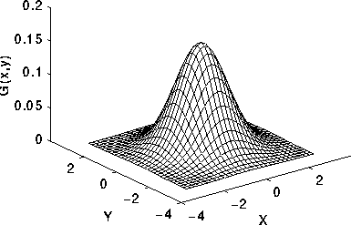
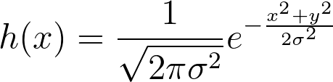
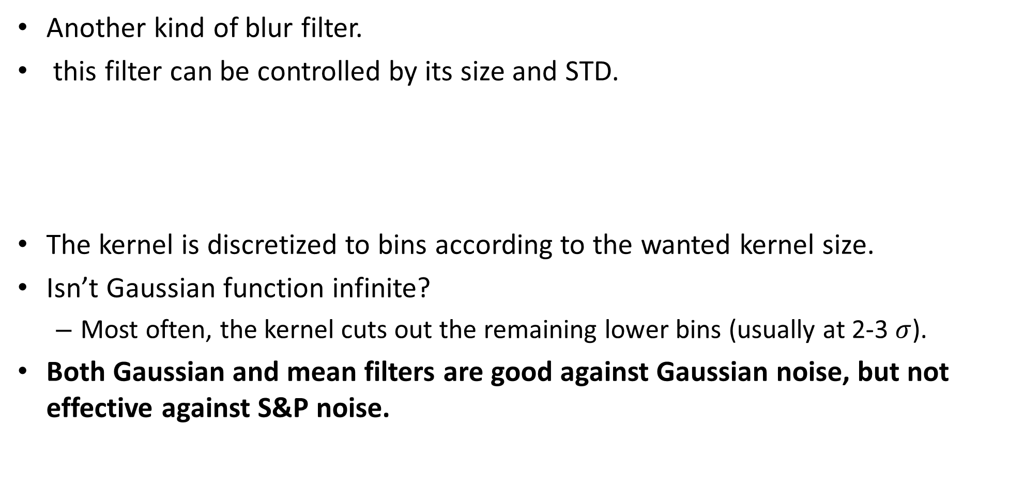
Gaussian filter
Another kind of blur filter.
this filter can be controlled by its size and STD.
The kernel is discretized to bins according to the wanted kernel size.
Isn’t Gaussian function infinite?
Most often, the kernel cuts out the remaining lower bins (usually at 2-3 $σ$).
Both Gaussian and mean filters are good against Gaussian noise, but not effective against S&P noise.
Notes:
h(x) = \frac{1}{\sqrt{2\pi \sigma^2}} e^{-\frac{x^2+y^2}{2 \sigma^2}}

Slide 21
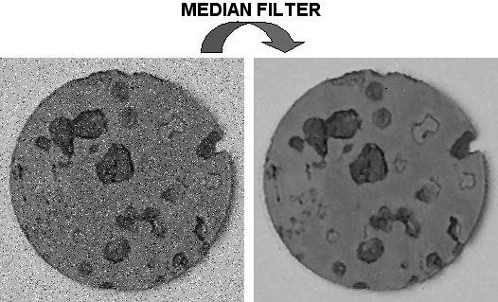
Median filter
Takes the median value from the given neighbors.
For example:
The median of [1, 0, 100] is 1.
Median filter is good against salt and pepper noise & against Gaussian noise (but not as effective).
Can be considered as a blur filter, but also has edge preserving properties.
Median filter is more computationally expansive than mean/gaussian.
This filter is not LTI because it’s not linear on some weights.
Notes:
if LxL size of kernel and MxN image size:
- Mean/ gaussian are separable- O(LMN) https://dsp.stackexchange.com/questions/36962/why-does-the-separable-filter-reduce-the-cost-of-computing-the-operator/36964
- median: O((L^2)MN)

Slide 22
contents
Noise and filtering
Frequency representation
Decimation
Interpolation

Slide 23
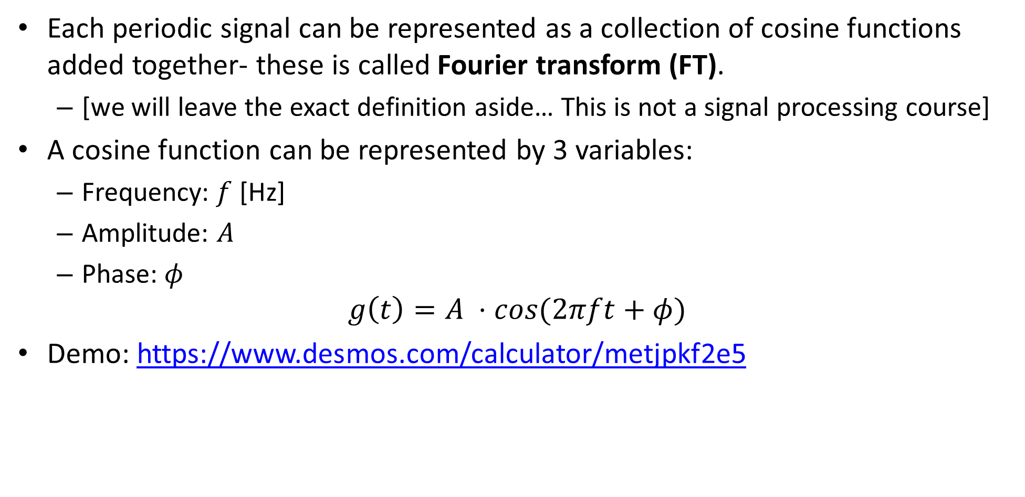
Fourier transform
Each periodic signal can be represented as a collection of cosine functions added together- these is called Fourier transform (FT).
[we will leave the exact definition aside… This is not a signal processing course]
A cosine function can be represented by 3 variables:
Frequency: $f$ [Hz]
Amplitude: $A$
Phase: $φ$
$$g\left(t\right)=A ⋅cos(2πft+φ)$$
Demo: https://www.desmos.com/calculator/metjpkf2e5

Slide 24
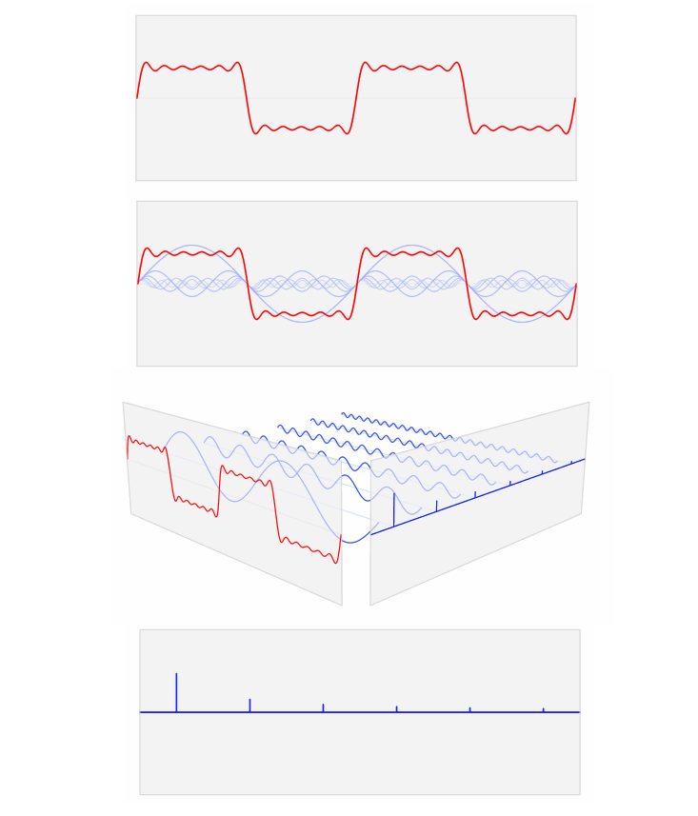
Fourier transform
FFT (fast Fourier transform) is an efficient algorithm to decompose a signal into its collection of added cosine functions: frequency, amplitude and phase.
Most of the times, when talking about the FFT of a signal, you’ll see graph of the frequencies and their belonging amplitudes (the phase is omitted).
FFT examples: http://www.jezzamon.com/fourier/

Slide 25
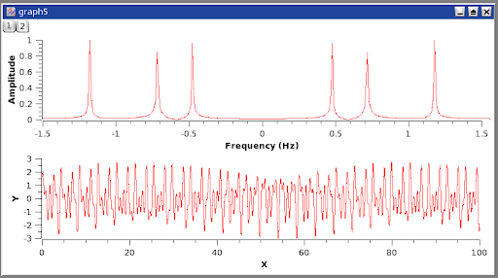
Fourier transform
When doing FT/FFT of a signal, one also get negative frequencies.
Why? Again, out of scope… this is the uniqueness of the Fourier transform and its ability to work on complex signals.
When the signal is real, the Fourier transform is symmetric and hence most of the time the negative part is erased.
The same is true for 2D signals, but there we tend to keep the symmetric part.

Slide 26
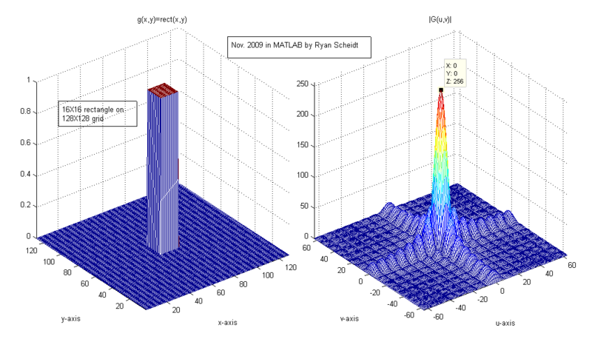
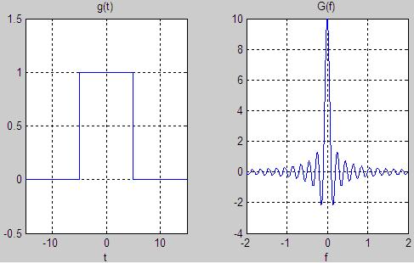
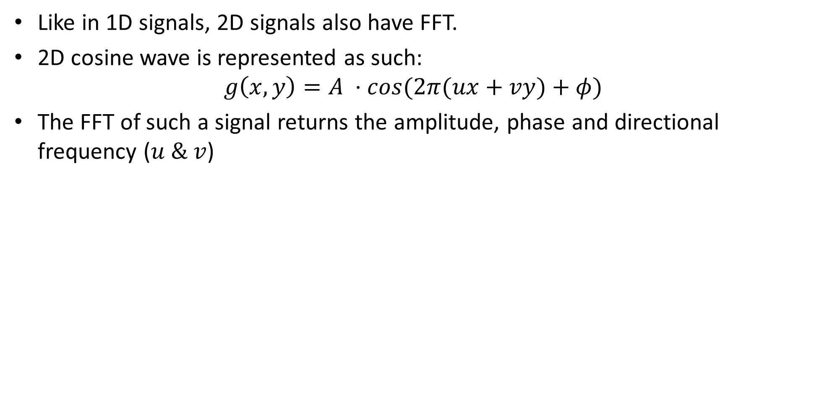
2D FFT
Like in 1D signals, 2D signals also have FFT.
2D cosine wave is represented as such:
$$g\left(x,y\right)=A ⋅cos(2π(ux+vy)+φ)$$
The FFT of such a signal returns the amplitude, phase and directional frequency ($u \& v$)

Slide 27
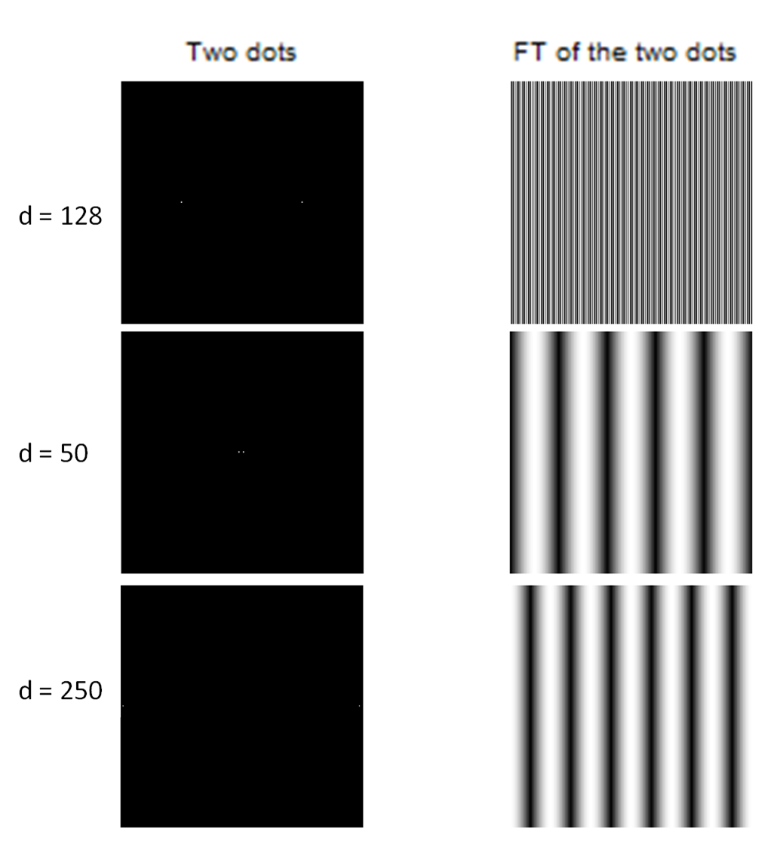
2D FFT examples

Slide 28
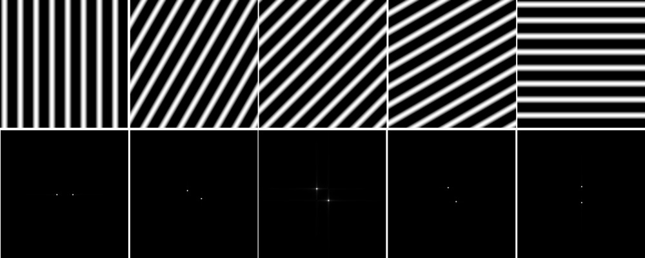
2D FFT examples

Slide 29
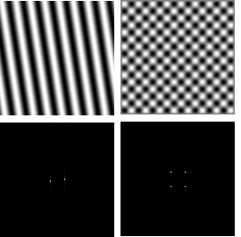
2D FFT examples

Slide 30
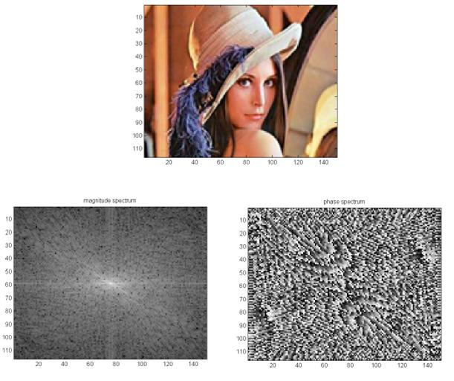
2D FFT examples

Slide 31
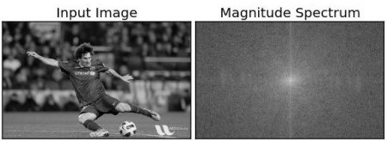
2D FFT
In audio signals (or any other 1D signals) Lower frequencies change less over time than higher frequencies.
In images, the change is represented in change in distance, so images that changes slowly from pixel to pixel has more lower frequencies then others.
Natural images are mainly built from low frequencies.
Low frequencies
High frequencies

Slide 32
2D FFT
2D FFT demo: http://www.jezzamon.com/fourierl#jpegs
[Actually DCT (discrete cosine transform) but it’s a good demo none the less)

Slide 33
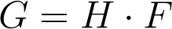
Convolution in frequency domain
Recall: in time (space) domain:
In frequency domain- simple multiplication:
Notes:
G=H \cdot F

Slide 34
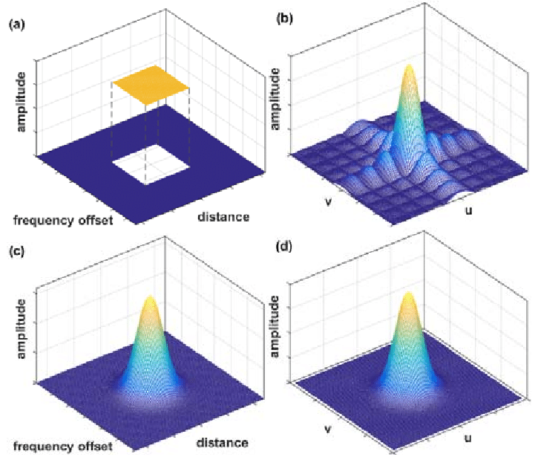
Low-pass filters
Both mean and Gaussian filters are considered low-pass filters because in the frequency domain, they have higher values in the lower frequencies- and when multiplied with frequency spectrums, the high frequencies get smaller.
When image is left only with the lower frequencies, the rapidly changes parts of the image (e.g.: edges, noise) are smoothen.

Slide 35
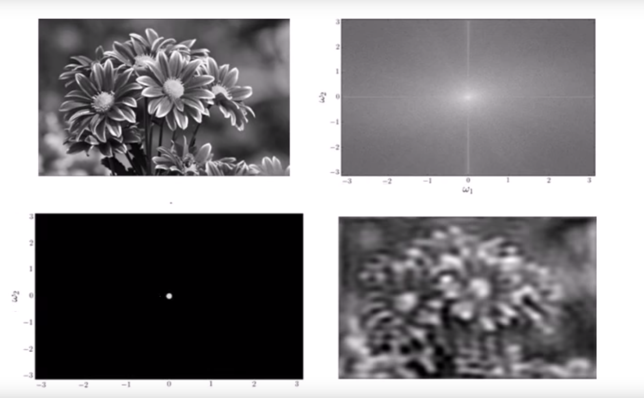
LP example

Slide 36
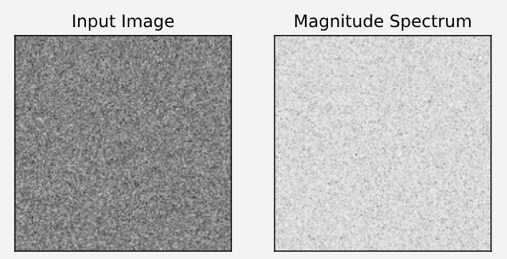
FFT of gaussian noise
Since gaussian noise (AWGN) is distributed along all frequencies, LP filter reduce this kind of noise significantly.

Slide 37
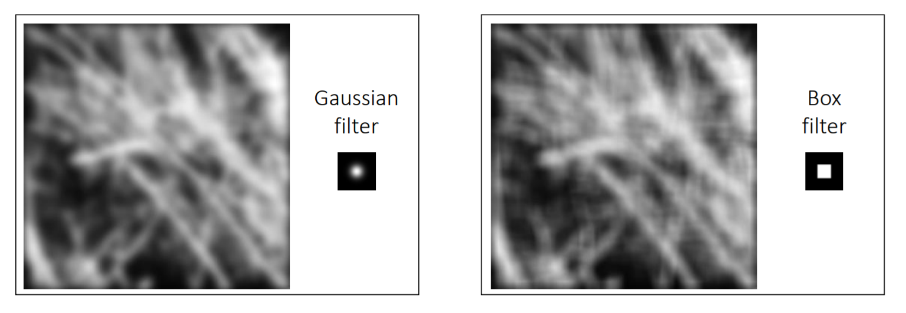
Mean vs. Gaussian filter
Since Mean filter has some high values in high frequencies, edge artifacts sometimes remains.
Gaussian filter has less artifacts in higher frequencies.

Slide 38
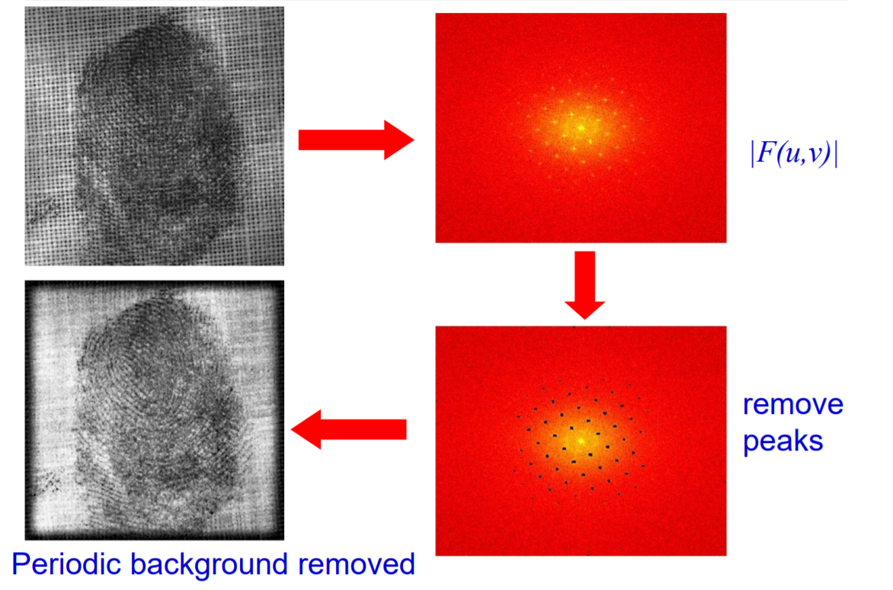
More applications with frequencies
Forensics
http://www.robots.ox.ac.uk/~az/lectures/ia/lect2.pdf

Slide 39
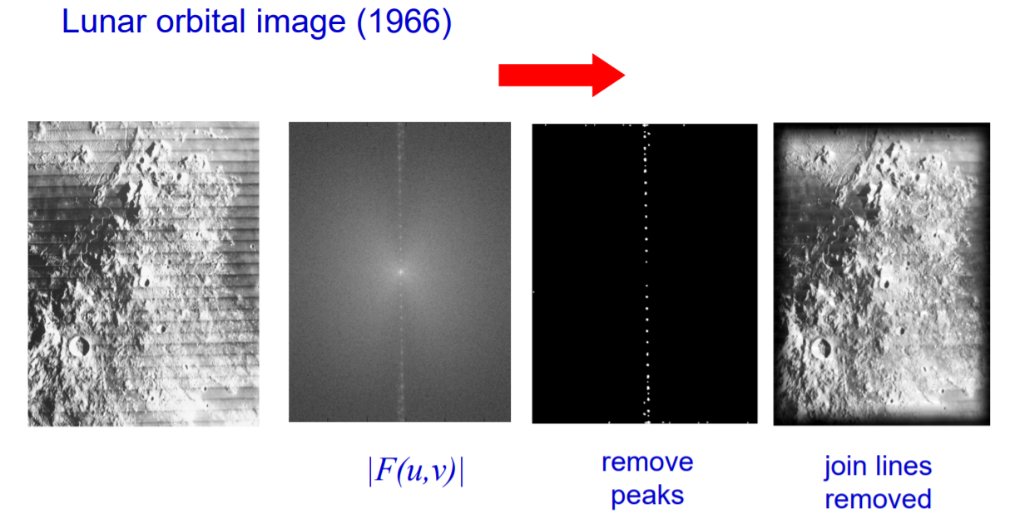
More applications with frequencies

Slide 40
contents
Noise and filtering
Frequency representation
Decimation
Interpolation

Slide 41
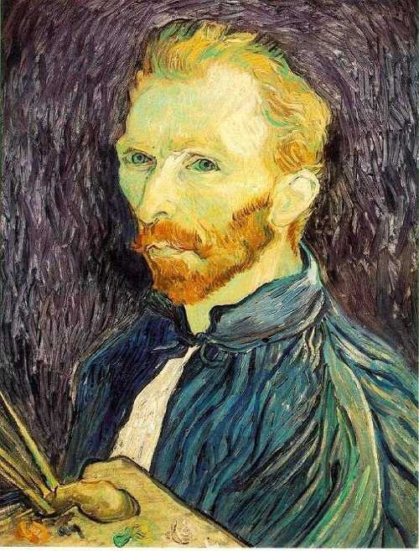
Image Scaling
This image is too big to fit on the screen. How can we generate a half-sized version?
Source: S. Seitz

Slide 42

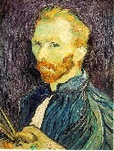

Image sub-sampling
Throw away every other row and column to create a 1/2 size image.
Called image sub-sampling or decimation.
Naïve subsampling examples:
1/8
1/4
Source: S. Seitz

Slide 43
Image sub-sampling
1/2
1/4 (2x zoom)
1/8 (4x zoom)
Source: S. Seitz

Slide 44
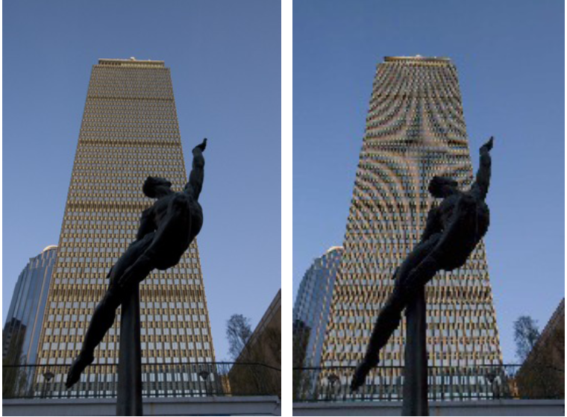
Image sub-sampling
Source: F. Durand

Slide 45
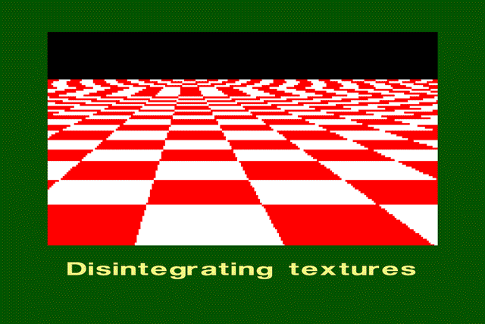
Even worse for synthetic images
Source: L. Zhang

Slide 46
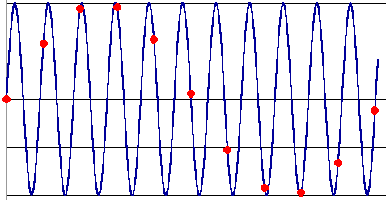
Aliasing
Occurs when the sampling rate is not high enough to capture the amount of details in the image.
Can give the wrong signal/image—an alias.
To do sampling right, need to understand the structure of your signal/image
To avoid aliasing:
sampling rate ≥ 2 * max frequency of the image.
This minimum sampling rate without aliasing is called the Nyquist rate.
Source: L. Zhang

Slide 47
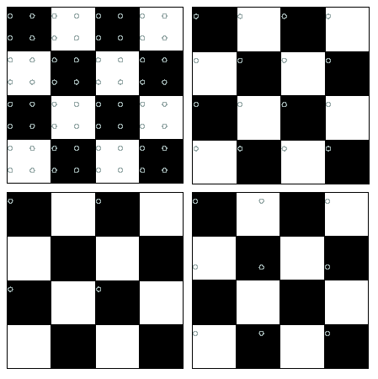
Nyquist limit – 2D example
Good sampling
Bad sampling

Slide 48
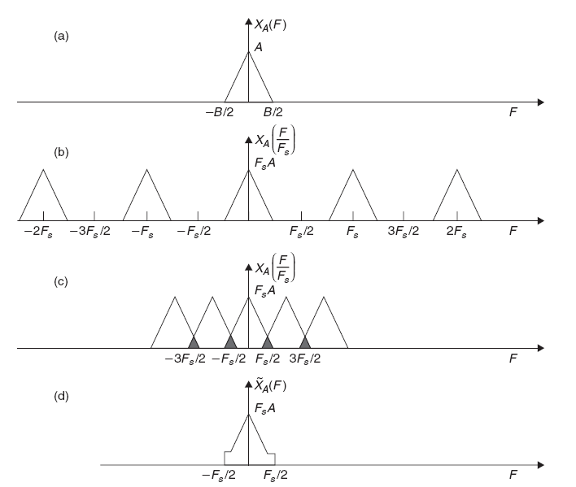
Nyquist limit- frequency response
Original frequency representation of signal.
Regular sampling above nyquist rate- can recreate the original frequencies of the image. (copies are from sampling).
Sampling below nyquist- original frequencies are destroyed due to the copies overlap- this is the aliasing.

Slide 49
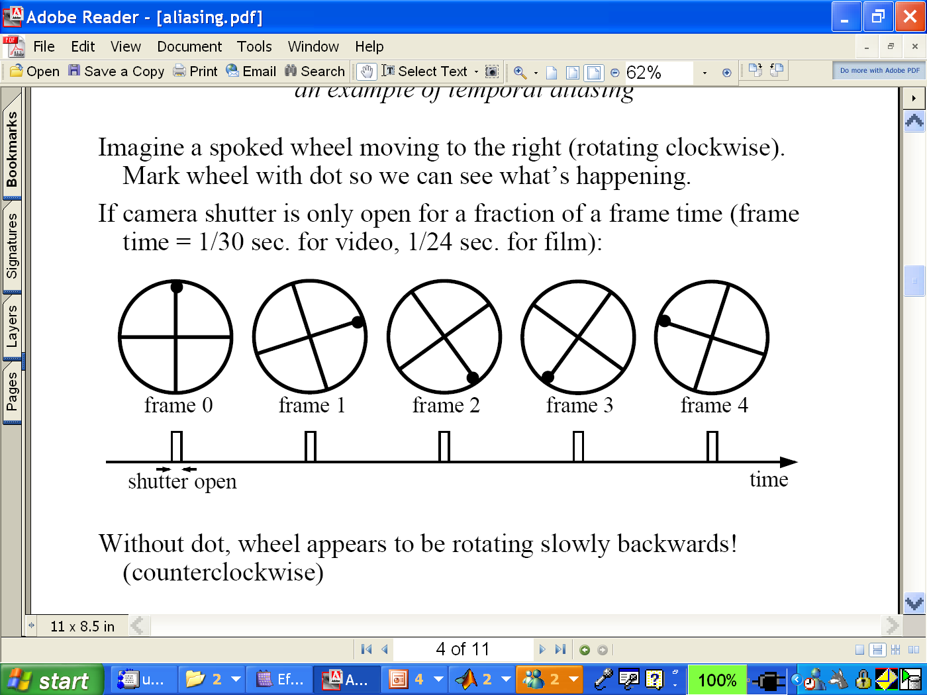
Example: wagon-wheel effect
An example of sub sampling in time domain (instead of spatially like before).
Without the dot, the wheel appears to be rotating slowly backwards (counterclockwise).
https://en.wikipedia.org/wiki/File:Propeller_strobe.ogv
https://en.wikipedia.org/wiki/File:The_wagon-wheel_effect.ogv

Slide 50



Gaussian pre-filtering
Solution: filter the image, then subsample
G 1/8
G 1/4
Gaussian 1/2
Source: S. Seitz

Slide 51
Subsampling with Gaussian pre-filtering
Solution: filter the image, then subsample
Gaussian 1/2
G 1/4
G 1/8
Source: S. Seitz

Slide 52
Compare with...
1/2
1/4 (2x zoom)
1/8 (4x zoom)
Source: S. Seitz

Slide 53
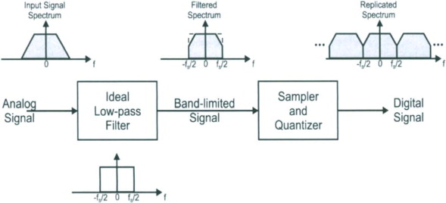
Low pass filtering- frequency response

Slide 54
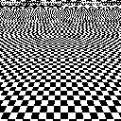
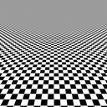
Back to the checkerboard
What should happen when you make the checkerboard smaller and smaller?
Image turns grey! (Average of black and white squares, because each pixel contains both.)
Naïve subsampling
Proper prefiltering
(“antialiasing”)

Slide 55
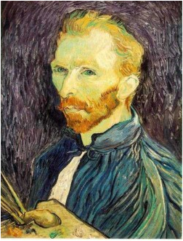







Gaussian pre-filtering
Solution: filter the image, then subsample
F₀
F₁
F₂
…
blur
subsample
blur
subsample
F₀ H
F₁ H
*
*

Slide 56
{
Gaussian pyramid
F₀
F₁
F₂
…
blur
subsample
blur
subsample
F₀ H
F₁ H
*
*

Slide 57
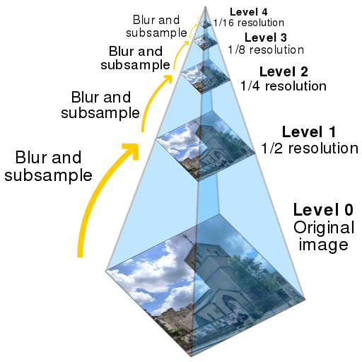
Gaussian pyramid

Slide 58
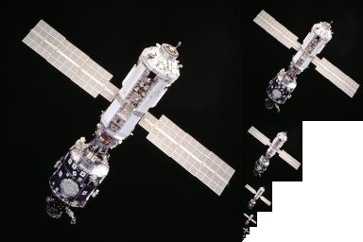
Gaussian pyramid

Slide 59
contents
Noise and filtering
Frequency representation
Decimation
Interpolation

Slide 60

Upsampling
This image is too small for this screen:
How can we make it 10 times as big?
Simplest approach: repeat each row and column 10 times (“Nearest neighbor interpolation”)
This operation is known as upsampling or interpolation.

Slide 61
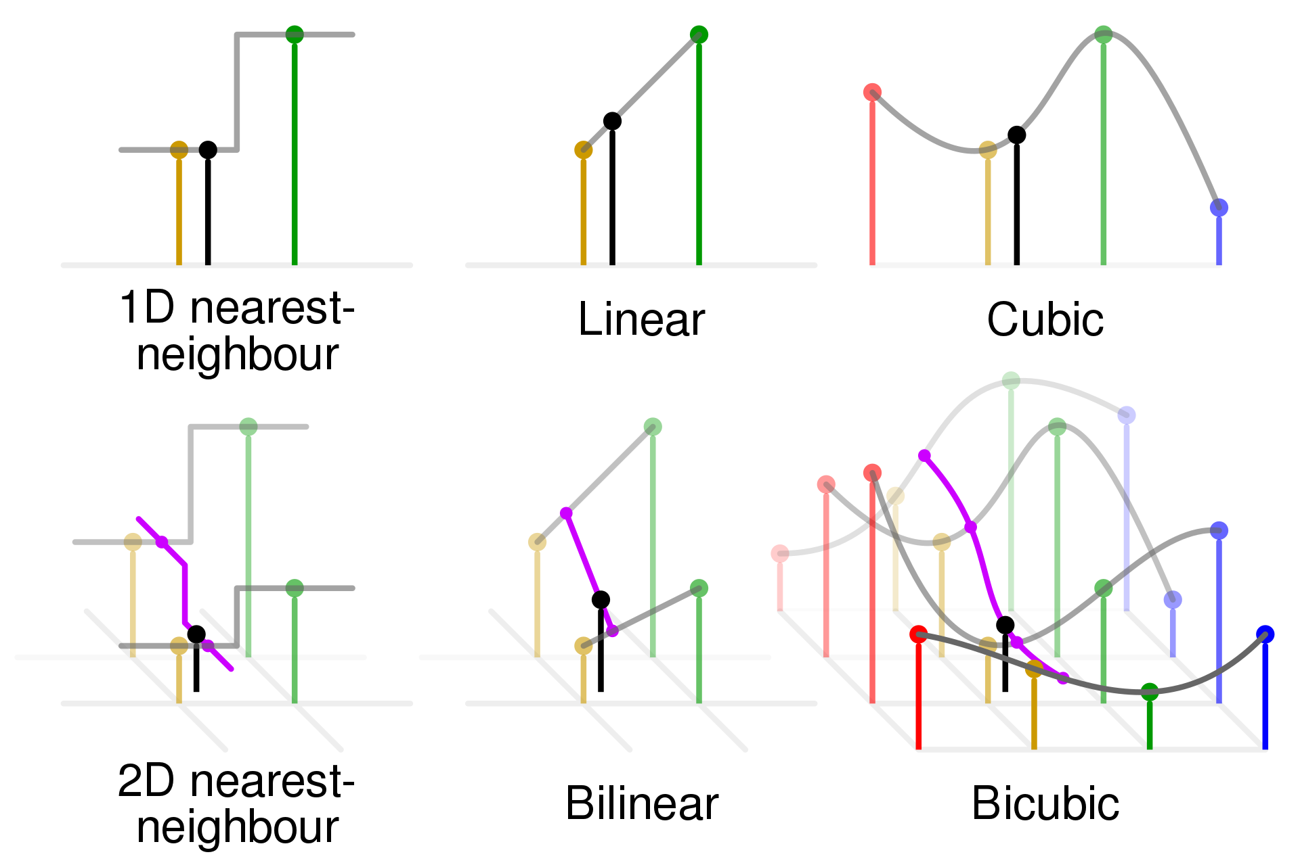
Upsampling

Slide 62


Upsampling
Nearest-neighbor interpolation
Bilinear interpolation
Bicubic interpolation

Slide 63


Upsampling
Also used for image warping

